Slide 1

Helping tourists go through the city

Slide 2

Problem
Tourists want to enjoy their stay in a foreign city or country.
They want to visit the best places.
Too much time is wasted deciding where to go and in which order should they visit the places.
People want to spend as little time as possible travelling between venues.
The city chosen to do this work is Santiago, Chile.

Slide 3
Data sources and cleaning
Venue information was taken from the Foursquare API
Venue’s “comunas” where taken from maps downloaded from https://www.bcn.cl/siit/mapas_vectoriales.
Venue’s assignment to each comuna was made by calculating the distance to the comuna’s centroid.
Some misclassified venues were corrected by assigning the comuna in its name if the venue had the comuna’s name in its venue name.

Slide 4
Feature Selection
From Foursquare API: Venue Id, Venue name, Venue Latitude, Venue Longitude, Venue Category and Venue Ratings,
From map information: Comuna Centroid Latitude, Comuna Centroid Longitude and Comuna Name.
Calculated: Distance to Comuna’s Centroid.
Note: user needs to input venue categories that he wants to visit.

Slide 5

Comunas with most venues
Comuna | Number of venues
Santiago | 113
Ñuñoa | 99
Providencia | 99
Maipú | 98
Puente Alto | 96
Vitacura | 96
La Reina | 93
San Bernardo | 81
La Florida | 80
San Miguel | 78
Las Condes | 74

Slide 6
Most Popular Comunas
Comuna | Ratings number
Providencia | 20272
Santiago | 18429
Ñuñoa | 12700
Pudahuel | 9340
Vitacura | 8961
Las Condes | 5471
San José de Maipo | 3767
La Florida | 3497
La Reina | 3490
Lo Barnechea | 3419

Slide 7
Most common venues for popular comunas
Comuna | 1st Most Common Venue | 2nd Most Common Venue | 3rd Most Common Venue | 4th Most Common Venue | 5th Most Common Venue
Providencia | Sandwich Place | Restaurant | Bar | Pizza Place | French Restaurant
Santiago | Coffee Shop | Sandwich Place | Pizza Place | Park | Café
Ñuñoa | Bakery | Italian Restaurant | Restaurant | Café | Bar
Pudahuel | Airport Lounge | Coffee Shop | Hotel | Sushi Restaurant | Soccer Field
Vitacura | Café | Sushi Restaurant | Gym / Fitness Center | Italian Restaurant | Bakery
Las Condes | Bakery | Coffee Shop | Supermarket | Fast Food Restaurant | Multiplex
San José de Maipo | Scenic Lookout | Mountain | Restaurant | Hotel | Campground
La Florida | Sushi Restaurant | Chinese Restaurant | Pizza Place | Gym | Soccer Stadium
La Reina | Restaurant | Sushi Restaurant | Soccer Field | Chinese Restaurant | Pizza Place
Lo Barnechea | Ski Area | Hotel | Mountain | Restaurant | Trail

Slide 8
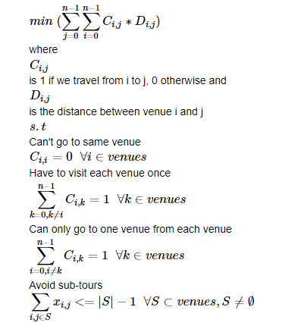
Optimization problem
To optimize our routes we have to solve the following integer optimization problem

Slide 9
Results
Venue categories used for our example are:
Stadium
Park
Sushi Restaurant
Art Museum
The program recommends us to visit:
Movistar Arena
Niu Sushi
Parque Padre Hurtado
Palacio La Moneda

Slide 10

Results
Algorithm output after optimizing our route:

Slide 11
Discussion
Good first approach to optimize venue routes and ratings.
Setbacks:
Distance errors
It doesn’t consider street grids or traffic.
Doesn’t consider best time of the day to visit each venue.
Further work to be done:
We could use Google API alongside Foursquare API to get traffic and route information.
Personalized recommendations by using a collaborative filter

Slide 12
Conclusions
First approach to optimize traveler’s routes.
Foursquare API data is very useful for this kind of problem, however, further data could be taken from Google API.
Travelling salesman problem is a good approach to the problem presented here.

